Slide 1
Pre-calc trig
Day 40

Slide 2
Chapter 1 Functions and Their Graphs
Level 2
Find Domain and Range (2 problems) Given f(x) and g(x) Evaluate (4 problems)
Level 3
Evaluate composition function from table (1 problem) Evaluate composition problem given functions (1 problem) Find inverse (1 problem)
Level 4
Write, solve, and interpret an equation (1 problem)

Slide 3
Chapter 2 Polynomials and Rational Functions
Level 2
Find vertex and x-intercepts (1 problem) Solve the following quadratics (3 problems) Simplify negative radical (1 problem) Identify a Horizontal Asymptote (1 problem)
Level 3
Given a factor of a polynomial find the other zeros (1 problem) Describe end behavior (1 problem) Find limit (1 problem)
Level 4
Use limit to find slope of tangent (1 problem)

Slide 4
Chapter 3 Exponential and Logarithmic Functions
Level 2
Rewrite log and exponential form (2 problems) Evaluate logs (2 problems)
Level 3
Solve exponential and log functions (2 problems)
Level 4
Solve a compound continuously story problem (1 problem)

Slide 5
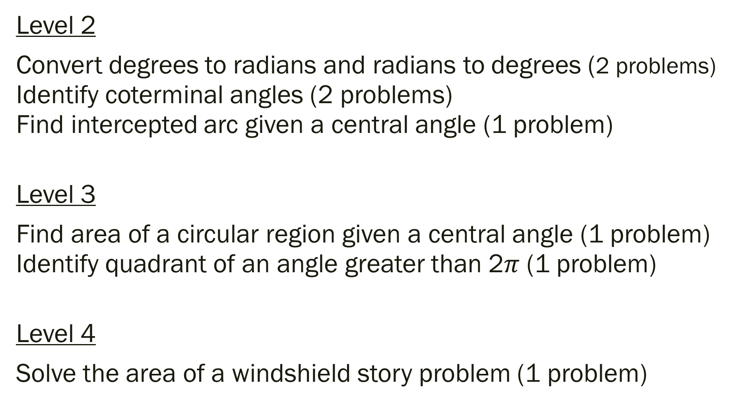
Chapter 4 (Section 1) Radians & Degrees Measure
Level 2
Convert degrees to radians and radians to degrees (2 problems) Identify coterminal angles (2 problems) Find intercepted arc given a central angle (1 problem)
Level 3
Find area of a circular region given a central angle (1 problem) Identify quadrant of an angle greater than 2$π$ (1 problem)
Level 4
Solve the area of a windshield story problem (1 problem)

Slide 6
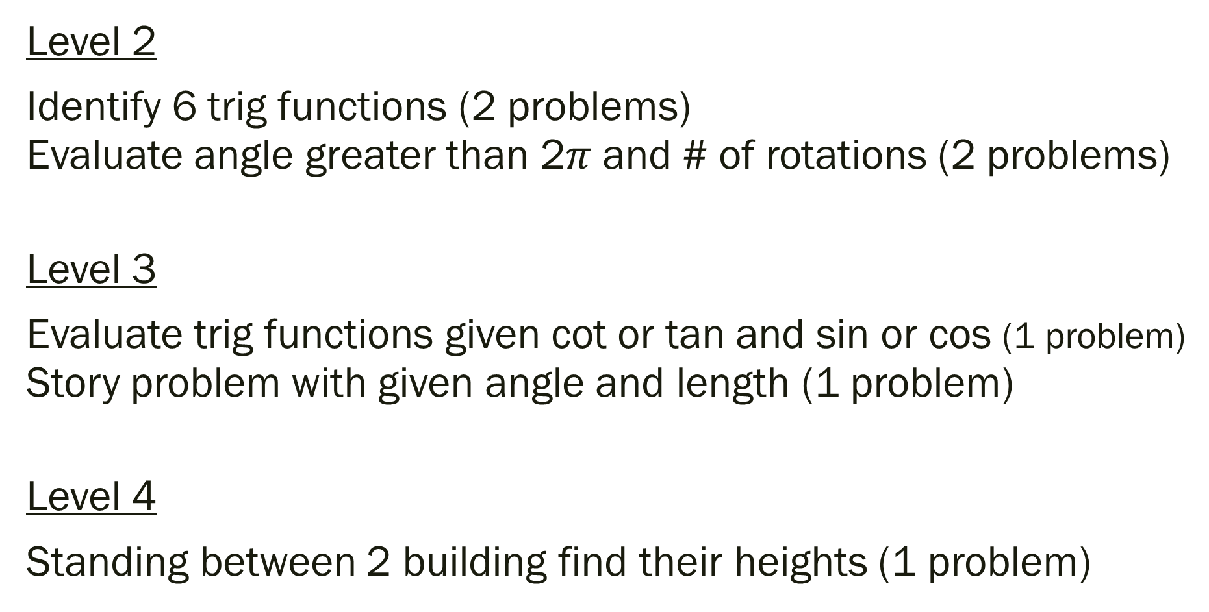
Chapter 4 (Section 2) Trigonometry
Level 2
Identify 6 trig functions (2 problems) Evaluate angle greater than 2$π$ and # of rotations (2 problems)
Level 3
Evaluate trig functions given cot or tan and sin or cos (1 problem) Story problem with given angle and length (1 problem)
Level 4
Standing between 2 building find their heights (1 problem)

Slide 7
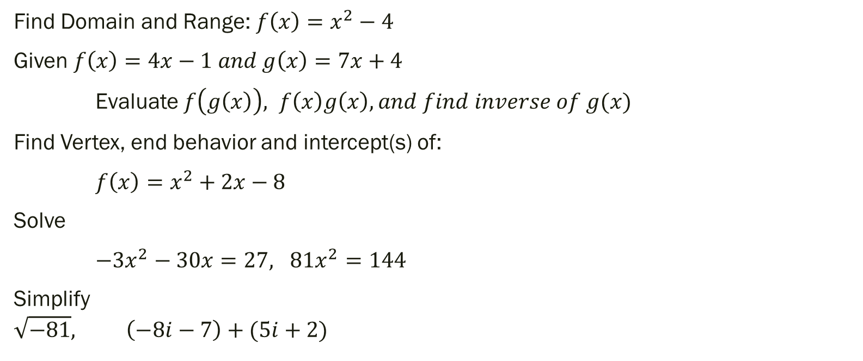
Some Chapter 1 and Chapter 2 Examples of Level 2 and/or Level 3
Find Domain and Range: ${f\left(x\right)=x}^{2}−4$
Given $f\left(x\right)=4x−1 and g\left(x\right)=7x+4$
Evaluate $f\left(g\left(x\right)\right), f\left(x\right)g\left(x\right), and find inverse of g(x)$
Find Vertex, end behavior and intercept(s) of:
${f\left(x\right)=x}^{2}+2x−8$
Solve
$−3x^{2}−30x=27, 81x^{2}=144$
Simplify
$$\sqrt{−81}, \left(−8i−7\right)+(5i+2)$$

Slide 8
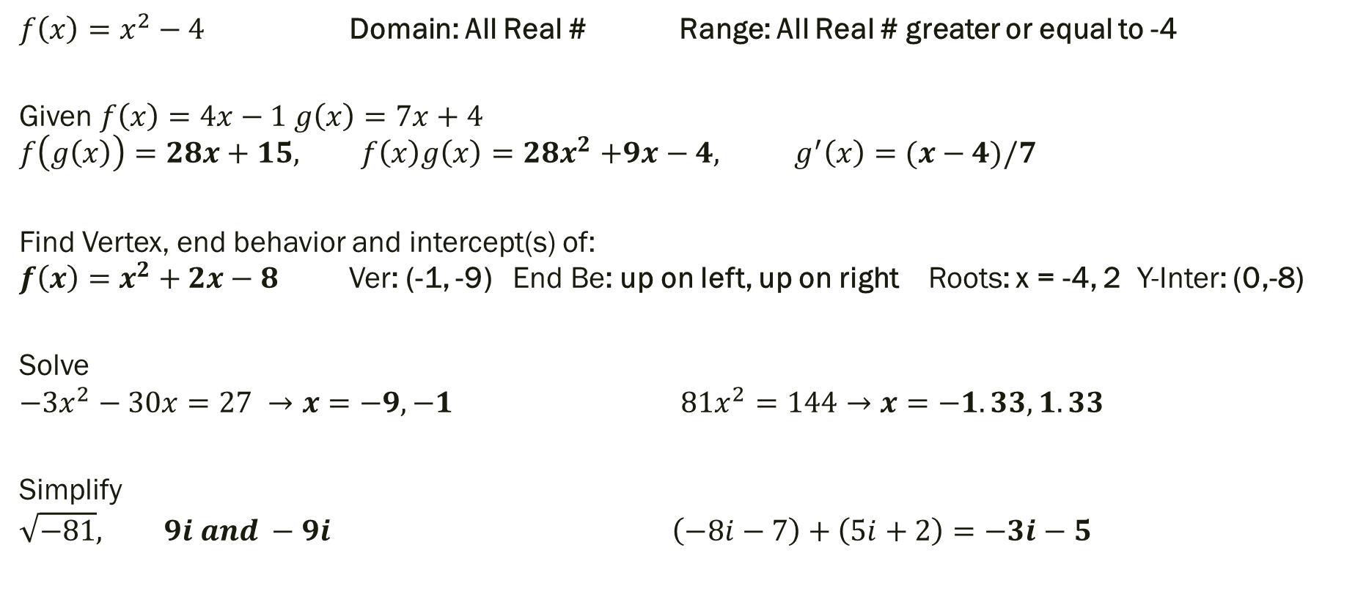
Some Chapter 1 and Chapter 2 Solutions
${f\left(x\right)=x}^{2}−4$ Domain: All Real # Range: All Real # greater or equal to -4
Given $f\left(x\right)=4x−1 g\left(x\right)=7x+4$ $$f\left(g\left(x\right)\right)=28x+15, f\left(x\right)g\left(x\right){=28x}^{2}+9x−4, g^{′}\left(x\right)=(x−4)/7$$
Find Vertex, end behavior and intercept(s) of: ${f\left(x\right)=x}^{2}+2x−8$ Ver: (-1, -9) End Be: up on left, up on right Roots: x = -4, 2 Y-Inter: (0,-8)
Solve
$$−3x^{2}−30x=27 →x=−9, −1 81x^{2}=144→x=−1.33, 1.33$$
Simplify
$$\sqrt{−81}, 9i and −9i \left(−8i−7\right)+\left(5i+2\right)=−3i−5$$

Slide 9

Some Chapter 3 Examples of Level 2 and/or Level 3
Rewrite$5^{2}=25$
Rewrite $\log_{16}4=0.5$
Evaluate $\log_{5}420$
Evaluate ${\ln{e}}^{2x}$
Solve ${9+4}^{2x+7}=169$
Solve $\log_{9}\left(4x−1\right)=1.25$

Slide 10

Some Chapter 3 Solutions
Rewrite$5^{2}=25$ $\log_{5}25=2$ Rewrite $\log_{16}4=0.5$ ${16}^{0.5}=4$
Evaluate $\log_{5}420$ 3.753
Evaluate ${\ln{e}}^{2x}$ 2x
Solve ${9+4}^{2x+7}=169$ $x=−1.6695$
Solve $\log_{9}\left(4x−1\right)=1.25$ $x=4.147$

Slide 11
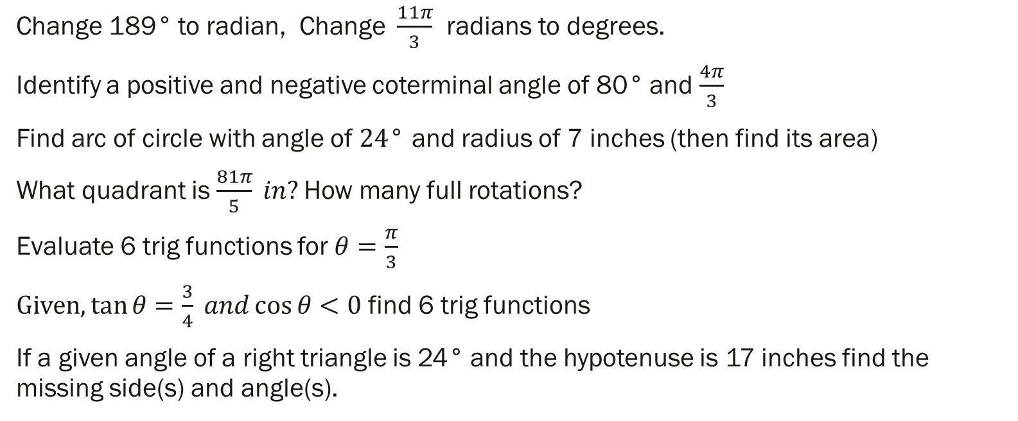
Some Chapter 4 Examples of Level 2 and/or Level 3
Change 189° to radian, Change $\frac{11π}{3}$ radians to degrees.
Identify a positive and negative coterminal angle of 80° and $\frac{4π}{3}$
Find arc of circle with angle of $24\text{°}$ and radius of 7 inches (then find its area)
What quadrant is $\frac{81π}{5} in?$How many full rotations?
Evaluate 6 trig functions for $θ=\frac{π}{3}$
$Given, tan{θ}=\frac{3}{4} and\cos{θ}<0$ find 6 trig functions
If a given angle of a right triangle is 24° and the hypotenuse is 17 inches find the missing side(s) and angle(s).

Slide 12
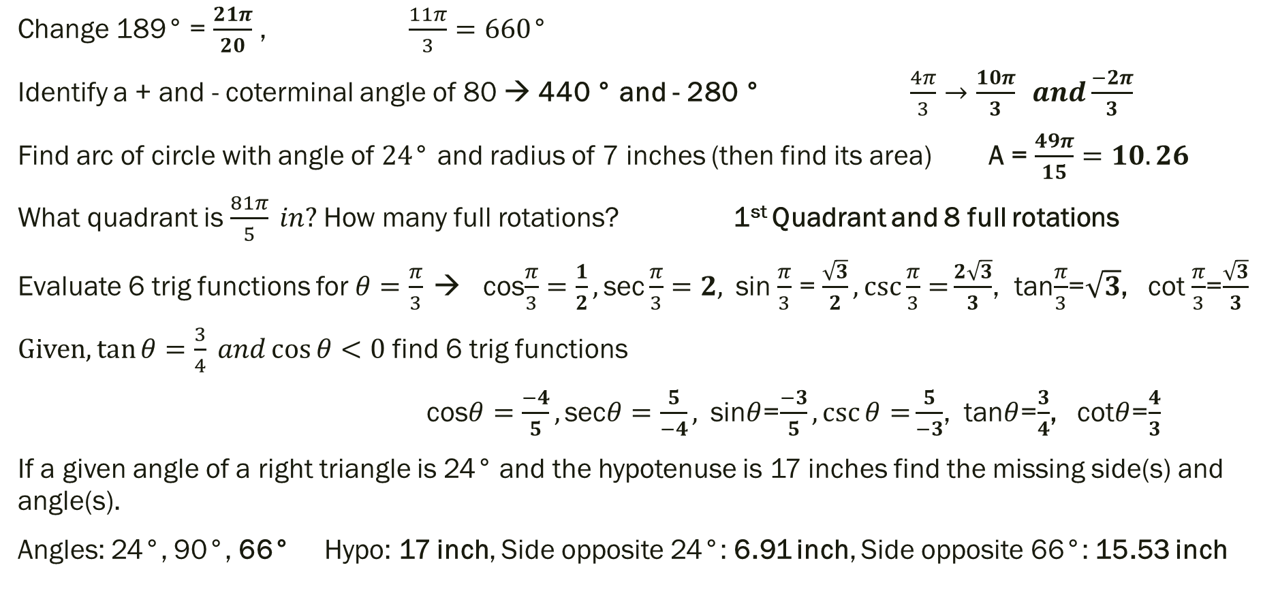
Some Chapter 4 Solutions
Change 189° = $\frac{21π}{20}$ , $\frac{11π}{3}=660$°
Identify a + and - coterminal angle of 80 → 440 ° and - 280 ° $\frac{4π}{3}→\frac{10π}{3} and\frac{−2π}{3}$
Find arc of circle with angle of $24\text{°}$ and radius of 7 inches (then find its area) A = $\frac{49π}{15}=10.26$
What quadrant is $\frac{81π}{5} in?$How many full rotations? 1st Quadrant and 8 full rotations
Evaluate 6 trig functions for $θ=\frac{π}{3}$ → cos$\frac{π}{3}=\frac{1}{2},\text{s}\text{ec}\frac{π}{3}=2,$sin $\frac{π}{3}$ = $\frac{\sqrt{3}}{2},\csc{\frac{π}{3}=}\frac{2\sqrt{3}}{3}$, tan$\frac{π}{3}$=$\sqrt{3}$, cot $\frac{π}{3}$=$\frac{\sqrt{3}}{3}$
$Given, tan{θ}=\frac{3}{4} and\cos{θ}<0$ find 6 trig functions
cos$θ=\frac{−4}{5},\text{sec}θ=\frac{5}{−4},$sin$θ$=$\frac{−3}{5},\csc{θ=}\frac{5}{−3}$, tan$θ$=$\frac{3}{4}$, cot$θ$=$\frac{4}{3}$
If a given angle of a right triangle is 24° and the hypotenuse is 17 inches find the missing side(s) and angle(s).
Angles: 24°, 90°, 66° Hypo: 17 inch, Side opposite 24°: 6.91 inch, Side opposite 66°: 15.53 inch

Slide 13
Review Assignment(s)
Chapter 1: Read page 114 – 115
Chapter 2: Read page 204 – 205
Chapter 3: Read page 268 – 269
Chapter 4: Read page 362 – 363

